Slide 1


Nova Web Reports
View in Power BI
Last data refresh:
9/21/2024 2:48:43 AM UTC
Downloaded at:
9/21/2024 3:17:48 AM UTC

Slide 2
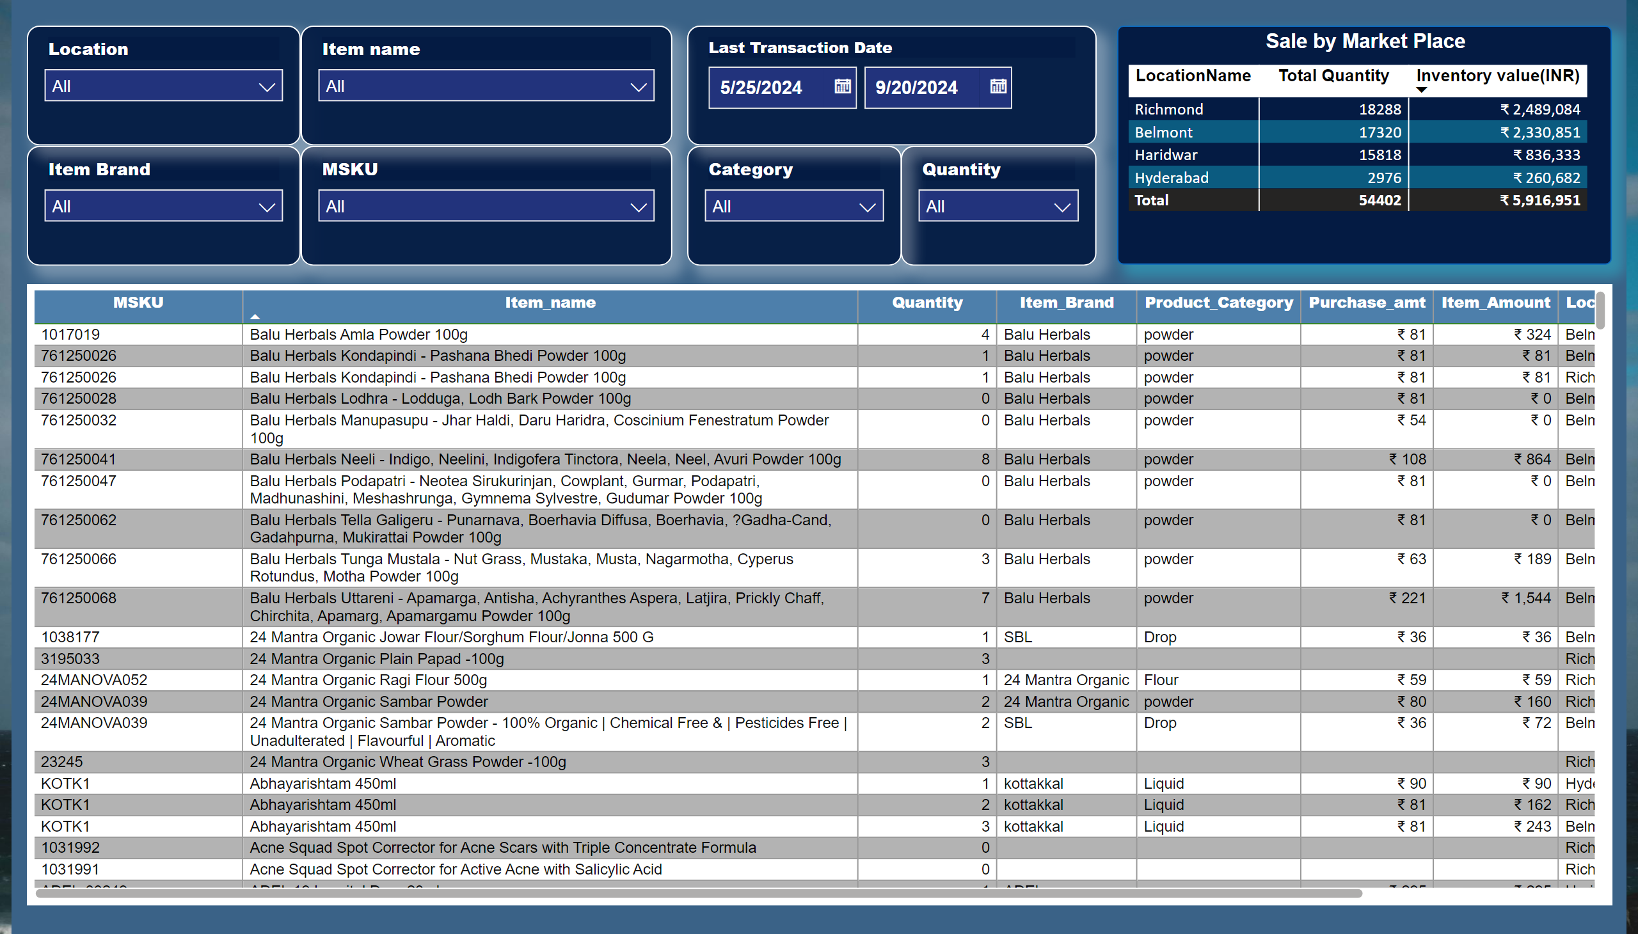
Stock Report
Notes:
tableEx
No alt text provided
slicer
No alt text provided
slicer
No alt text provided
slicer
No alt text provided
slicer
No alt text provided
slicer
No alt text provided
slicer
No alt text provided
Sale by Market Place
No alt text provided
slicer
No alt text provided

Slide 3
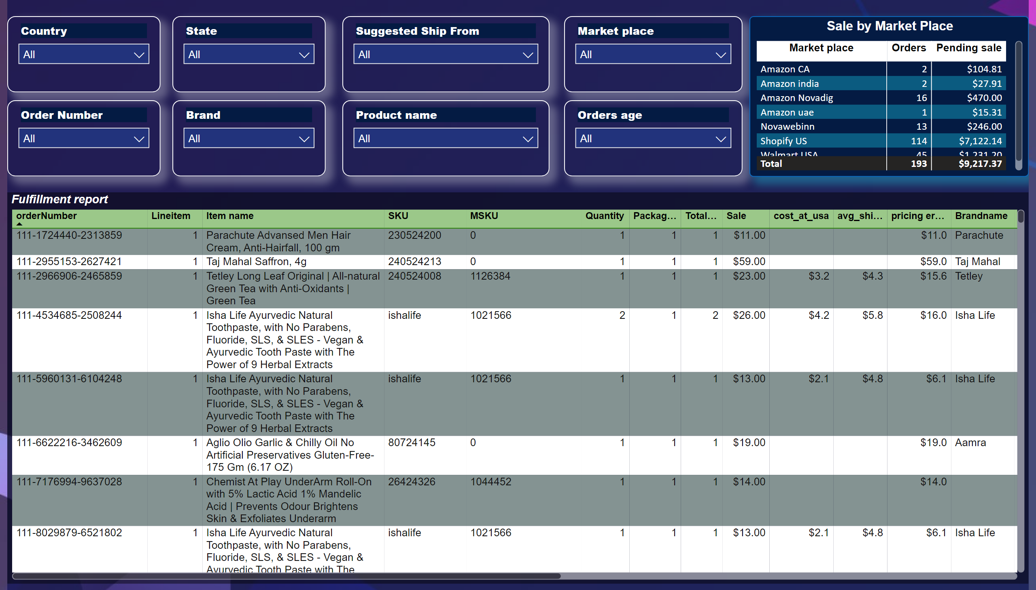
Fulfillment report
Notes:
Fulfillment report
No alt text provided
slicer
No alt text provided
slicer
No alt text provided
slicer
No alt text provided
slicer
No alt text provided
slicer
No alt text provided
slicer
No alt text provided
slicer
No alt text provided
Sale by Market Place
No alt text provided
slicer
No alt text provided

Slide 4
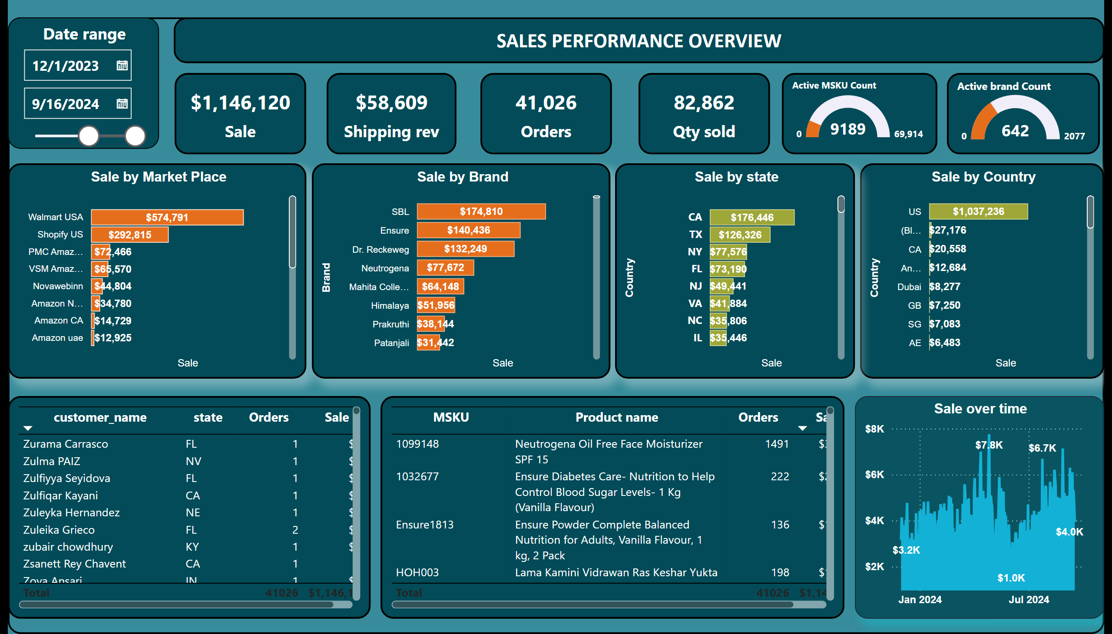
Sales report
Notes:
textbox
No alt text provided
Sale by state
No alt text provided
Sale
No alt text provided
Sale
No alt text provided
Active brand Count
No alt text provided
Active MSKU Count
No alt text provided
Sale
No alt text provided
Date range
No alt text provided
tableEx
No alt text provided
tableEx
No alt text provided
shape
No alt text provided
Sale
No alt text provided
Sale by Market Place
No alt text provided
Sale over time
No alt text provided
Sale by Brand
No alt text provided
Sale by Country
No alt text provided

Slide 5
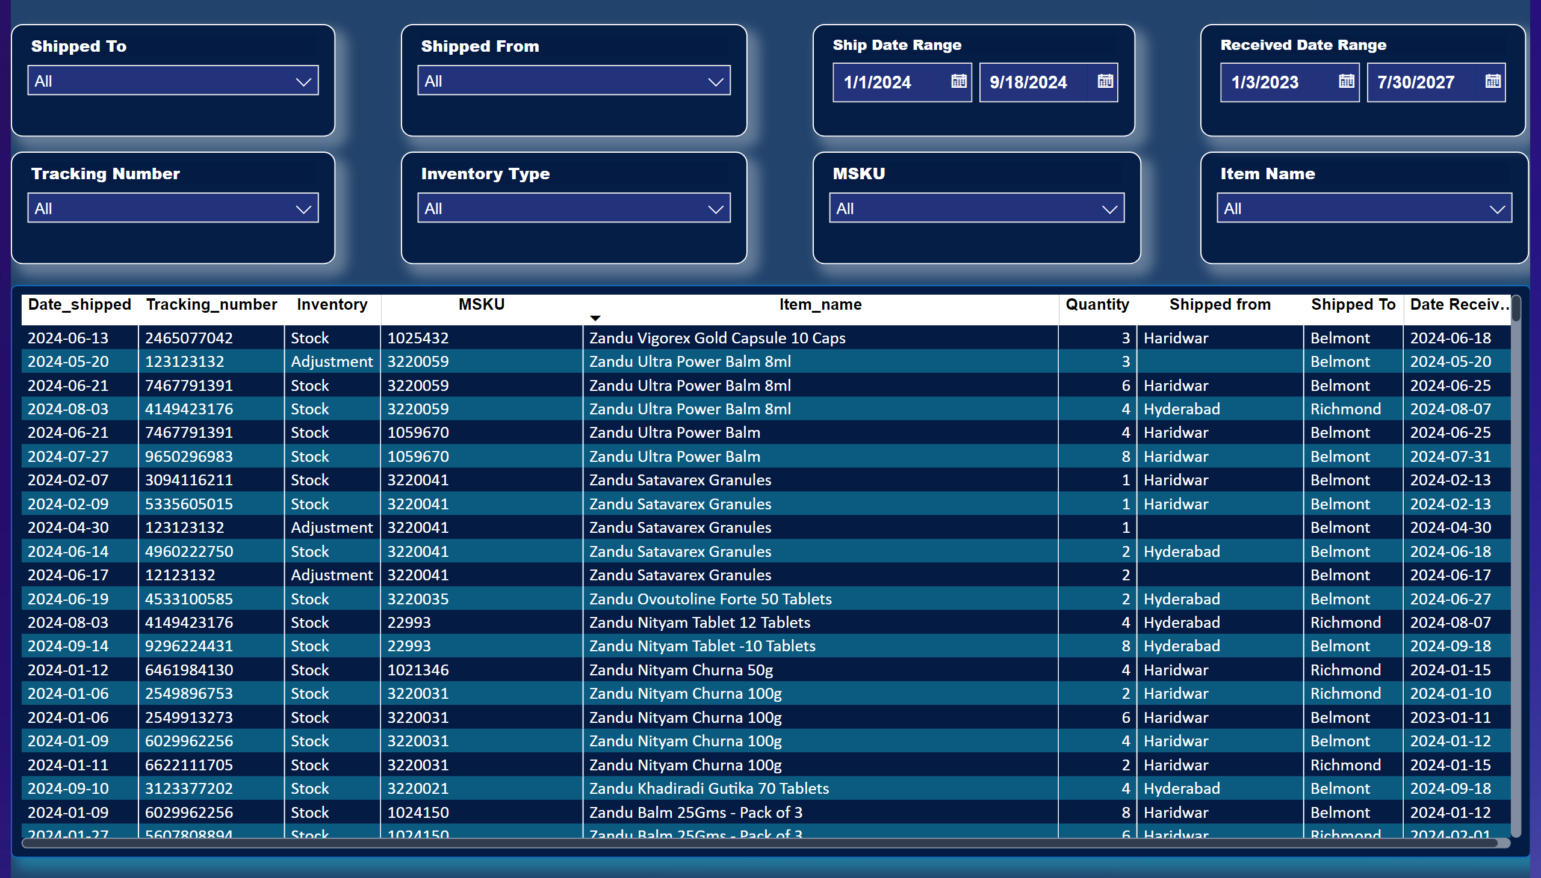
Stock transfer
Notes:
Sale by Market Place
No alt text provided
slicer
No alt text provided
slicer
No alt text provided
slicer
No alt text provided
slicer
No alt text provided
slicer
No alt text provided
slicer
No alt text provided
slicer
No alt text provided
slicer
No alt text provided

Slide 6
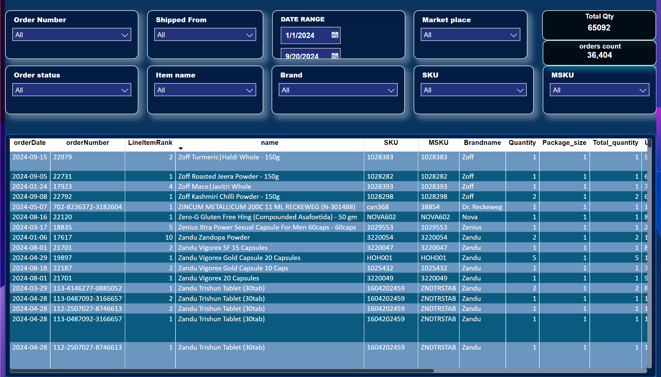
Order Details
Notes:
slicer
No alt text provided
slicer
No alt text provided
slicer
No alt text provided
slicer
No alt text provided
slicer
No alt text provided
slicer
No alt text provided
slicer
No alt text provided
slicer
No alt text provided
slicer
No alt text provided
Sale by Market Place
No alt text provided
Total Qty
No alt text provided
orders count
No alt text provided

